Slide 1
Handwashing In-Service
Month
YEAR
Notes:
Welcome the employees. Please remember to sign in so that we can ensure that 100% of the staff have been trained on the proper techniques in handwashing. The Centers for Disease Control, the Food & Drug Administration, and Centers for Medicare and Medicaid Services are constantly updating guidelines in order to ensure that we are practicing safe standards for our own safety and the safety of the patients or residents that we are serving.

Slide 2
Presenter’s Notes
Presentation Objective
Educate food service staff members on the importance of effective hand washing practices.
Educate food service staff members on proper hand washing procedures.
How to Use?
Please reference the presenter’s notes in the notes section for each slide. The most important content can be found in the presenters notes!
Feel free to adjust the presentation content to match your facility’s standard operating procedures for hand washing.
The in-service presentation begins on the next slide.
Michael Foods recommends the following resoruces to ensure you are following the best, science based handwashing tecniques and reccomendations…
Notes:
Notes for presenter, not for class room presentation.

Slide 3

FOOD SAFETY
Is in Your Hands
Notes:
Title slide for handwashing in-service.

Slide 4
Quality + Safety = Quality of Life
Standard
Operating
Procedure
Patient
or
Resident
Bacteria
&
Viruses
Hand-
washing
Notes:
We have a unique job. We are trying to prepare high quality food for our patients/residents and staff. At the same time we have to always be sure and follow the procedures that are in place at _________ that help us keep our food safe to eat. Our goal is to provide quality of life for our clients. In our kitchens there are many things that we do to make sure we serve a quality food product. We follow safe procedures and safe food handling practices to make the lives of our clients more pleasant. What we are doing is creating the quality of life that brings a smile to the faces of those we serve.
There are many things that can happen in our department that affect quality of life. Some of these factors are out of our control, but we can take steps to eliminate or reduce risks or factors that can make people sick or that can be potentially harmful. Look at this chart: SOP – standard operating procedures, bacteria or viruses – and handwashing can all affect our clients. Bacteria and viruses are on our hands and even in our food. This can be dangerous for our clients and for each other. (Did you know foodservice workers who practice poor hygiene can make each other sick, too?)
But we can follow SOPs to help eliminate or reduce bacteria and viruses. One way to do that is to wash your hands. So all three of these factors are related to client care and food safety.

Slide 5
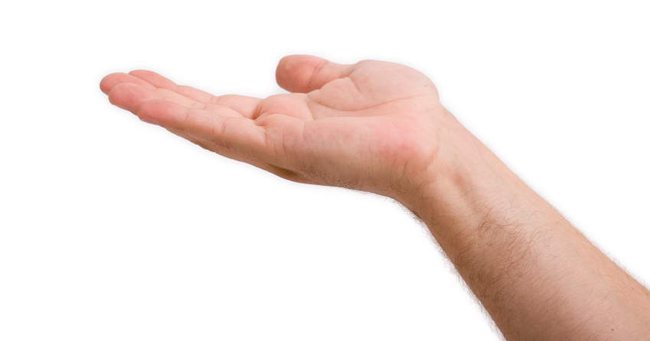
Food Safety is in Your Hands
Notes:
What that means is that the safety of food served at ______________is in our hands. Today we are going to take a look at our standard operating procedures for washing hands; and why that is important in keeping our kitchen and food safe from bacteria and viruses.

Slide 6
How many germs are on your hands?
?
Notes:
But first: Take a guess here!
How many germs do you think are in that little box?
[let everyone guess]
The answer is about: 650,000.
Now, how many germs would you guess it takes to make any one of us ill?
The answer is: As few as 10!
These are invisible threats, but they’re serious.

Slide 7
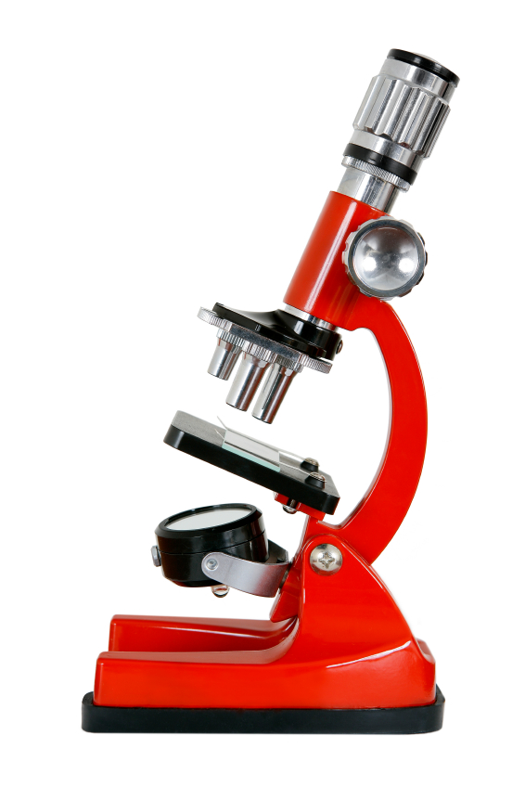
Foodborne Illness
Each year in the United States…
48,000,000 illnesses
128,000 hospitalizations
3,000 deaths
https://www.cdc.gov/foodborneburden/estimates-overview.html
Notes:
So now you know why we have Standard Operating Procedures. These are our routines we always follow to keep our patients healthy and our food safe to eat. Handwashing is an important procedure for many reasons. Bacteria and viruses that are present on our hands can be the cause or a factor in what is called foodborne illness. A foodborne illness occurs when certain germs from our hands touch food, and people eat the food. Our hands touch other things, too, like clean dishes, cooking utensils, and more. Germs can travel from our hands through these things to food… to our clients.
When germs travel through food, people can get sick and even lose their lives.
The Centers for Disease Control offer some quick facts to explain why this is so important. Over 76 million people become sick from foodborne illness every year.

Slide 8
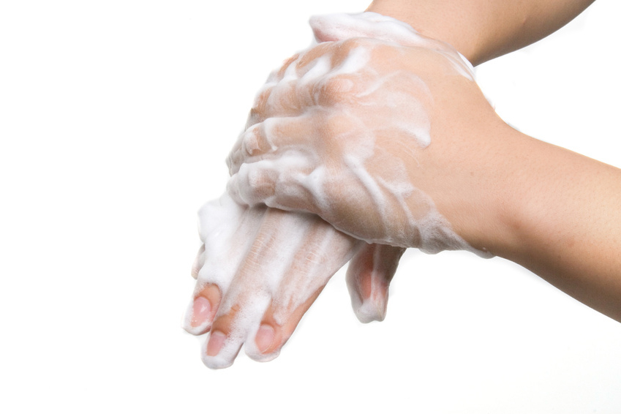
What can you do?
Wash Hands to…
Stop infections
Break chain of infection spreading
Stop growth of germs
Remove bacteria & viruses
Notes:
The good news is YOU can make a difference!
Germs can accumulate on your hands when you touch an object, touch your mouth, touch your nose or when you touch your eyes. The best thing you can do is wash your hands FREQUENTLY and EFFECTIVELY.

Slide 9
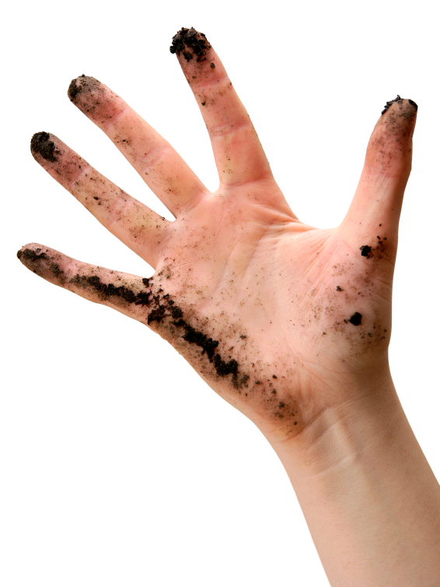
What germs are on your hands?
Notes:
Germs can accumulate on your hands when you touch an object, touch your mouth, touch your nose or when you touch your eyes.
Hundreds of different bacteria and viruses are in our world… and many are on our hands. Unfortunately, they’re not easy to see like dirt. … So the handwashing habit is crucial.

Slide 10
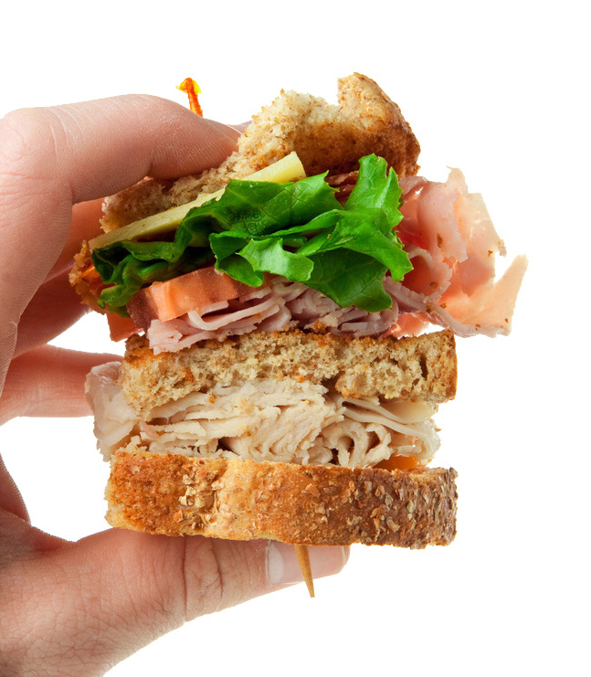
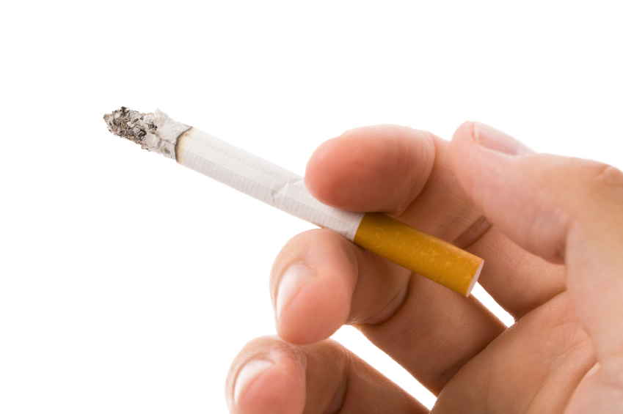
When do you wash your hands?
Notes:
When do you need to wash your hands?
Wash hands when you arrive at work.
Wash hands before you start to prepare any foods.
Wash hands before and after eating or drinking.
Wash hands after smoking.
Wash hands after you have used the bathroom.

Slide 11
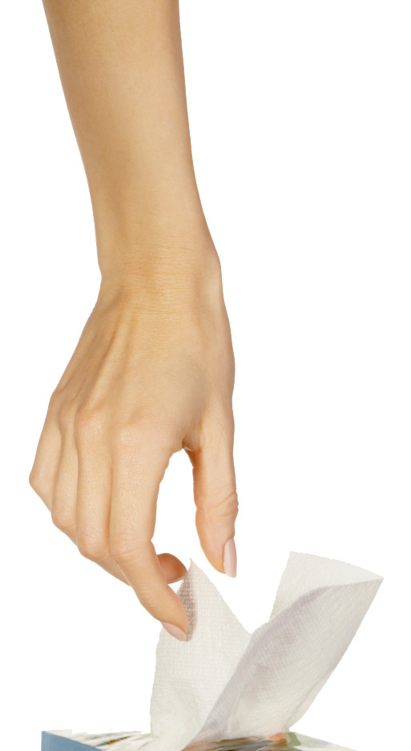
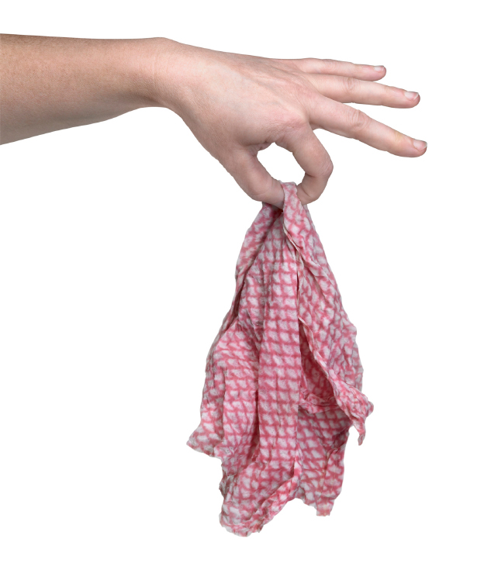
When do you wash your hands?
Notes:
Wash hands after you have sneezed.
Wash hands after cleaning or handling garbage.
Wash hands after taking off gloves and before putting on a new pair of gloves.
Wash hands after handling dirty equipment.
Wash hands after handling dishes or utensils.
Wash hands after touching raw meats, fish or poultry.
Wash hands anytime you change tasks to go from one thing to another.

Slide 12
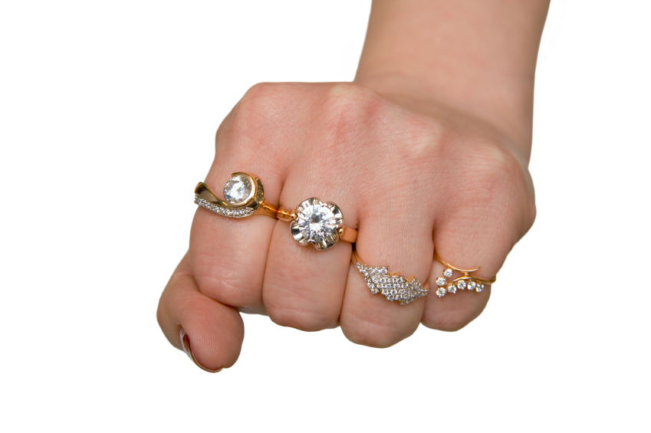
Rings and Things
Notes:
Part of hand hygiene is to remove all jewelry. Jewelry is lovely but does not belong in an area where food is being prepared. Why? Because germs can hide under rings and in little cracks.
You should remove jewelry before you come to work. A plain wedding band is the only acceptable piece of jewelry that may be worn.
You also need to keep fingernails short, with clear nail polish only. Artificial nails and painted nails can chip and fall into food. That’s dangerous.

Slide 13
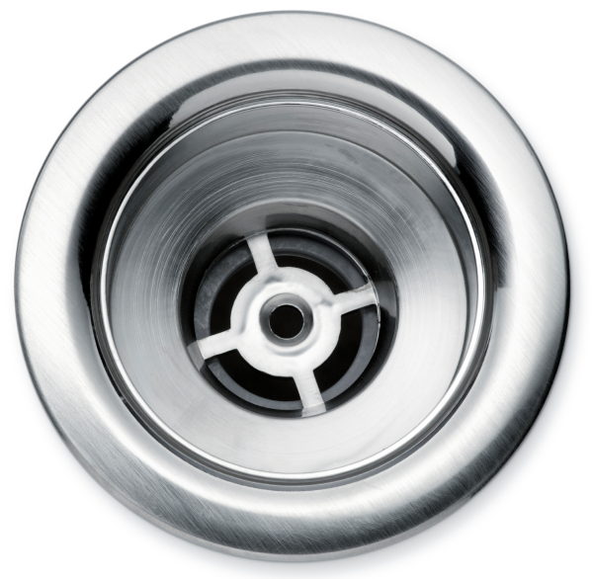
Where do you wash your hands?
Notes:
There are designated places to wash our hands. In our operation, we have are _______ handwashing sinks. These are the only places where you can wash your hands.
Why not in the dishwashing area? Why not in a food preparation sink?
Because germs from your hands – and the soap you use – can enter food and make our clients sick.

Slide 14
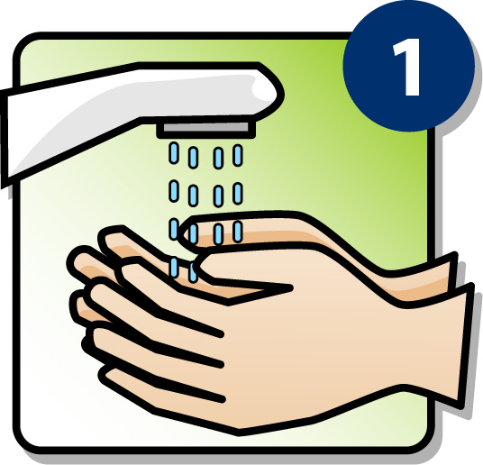
Step 1. Moisten Hands and Wrists
1
Notes:
Proper Handwashing begins with:
Step 1: Rinse or wet your hands with running water.

Slide 15
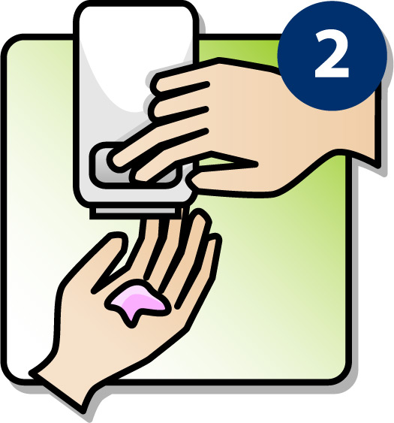
Step 2. Liquid Soap
2
Notes:
Step 2: Use liquid soap. Rub hands together with soap and lather well, covering all surfaces

Slide 16
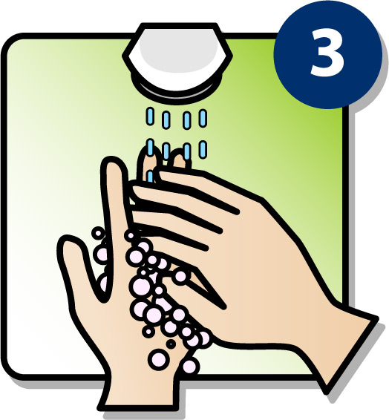
Step 3. Generate Heavy Lather
3
Notes:
Step 3: Lather the soap. Weave fingers and thumbs together and vigorously rub all surfaces of the hands. Wash under ring bands, cuticles, and fingernails. You need to do this for 20 seconds to loosen up any soil and germs. Count to at least 20!

Slide 17
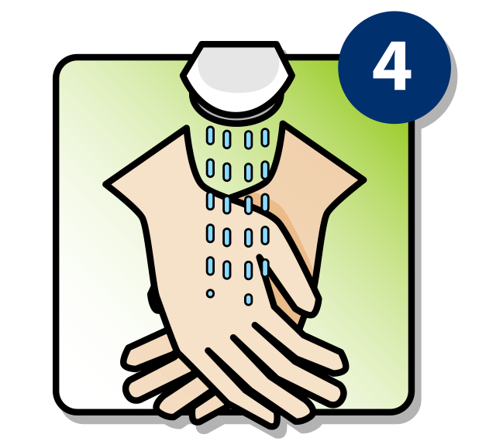
Step 4. Rinse Well
4
Notes:
Step 4: Rinse. Rinse hands under a stream of clean, running water until all of the soap is removed. Notice how the fingers are pointing down. This is so that water, dirt, and germs won’t drip towards the elbow.

Slide 18
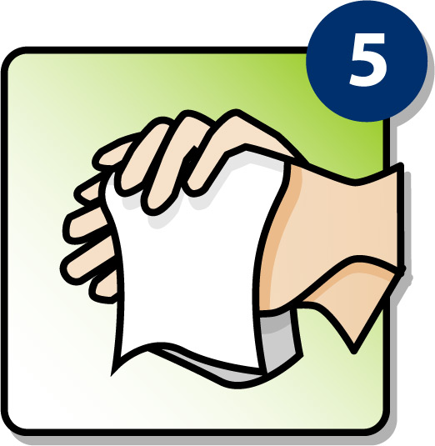
Step 5. Dry Hands with Paper Towel
5
Notes:
Step 5: Dry hands with a disposable towel or air dry hands. Do not use a dish towel or your apron.

Slide 19
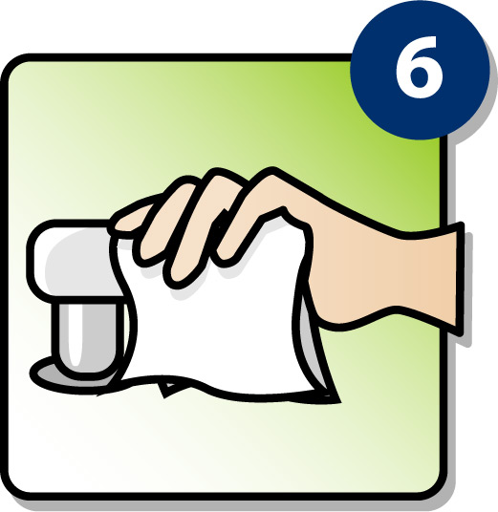
Step 6. Use Paper Towel To Turn Off Faucet
6
Notes:
Step 6: Turn off taps with a dry paper towel. This is so you don’t get new germs onto your hands form the faucet handle.

Slide 20
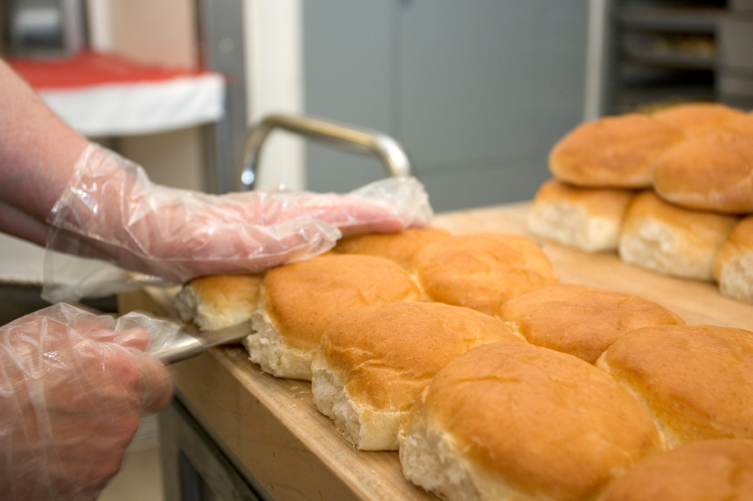
Gloves
Notes:
Gloves are also part of the standard operating procedure in making sure that food is safe. Gloves separate hands from food. We use gloves or utensils instead of bare hands any time we’re touching food that’s ready to be served.
But gloves can create false security. You think you’re being safe as long as gloves are on. Well…. Gloves can carry germs, too—
like hands. So, you need to change them frequently throughout the day.
Here are some tips:
Before you put on a pair of gloves, wash your hands.
After you take off your gloves, wash your hands.
Change gloves when they are torn or soiled.
Any time you would wash your hands (like after sneezing, using the bathroom, handling trash, handling raw meats, etc.) – Now you need to change your gloves.

Slide 21
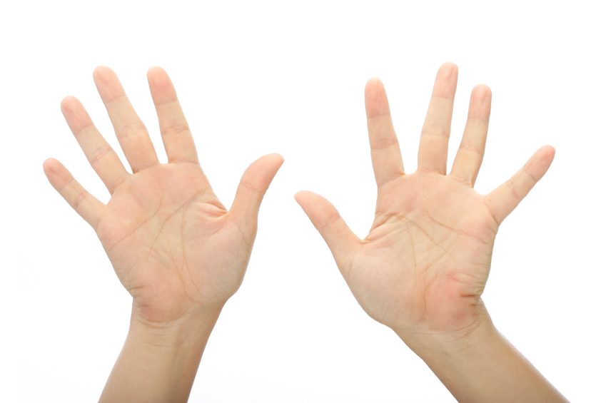
10 Deadly Weapons
Notes:
Remember, our hands can be the 10 most deadly weapons in our kitchen. So, we need to wash our hands often and frequently. Anytime you are getting ready to handle food, wash your hands!
Let’s do a quick review of the standard operating procedure for handwashing:
Moisten – get your hands wet.
Rub – liquid soap
Lather – 10-15 seconds
Rinse – rinse with the fingers pointing down.
Dry – dry with a paper towel or air dry
Use the paper towel to turn off the faucet.

Slide 22
Keeping Up With Safety Procedures
Notes:
It is so easy to get busy during the day and forget that what we do in this kitchen can greatly affect our clients. In long-term care or hospitals, we’re often helping people who can get sick easily.
When we remember to wash our hands – and wash our hands using the standard operating procedures discussed—we are helping our residents maintain and build their quality of life.
Healthcare is going through a culture change, and that means we work harder to keep the people we serve at the center of everything we do.
Clients need our help in making sure that we provide them with the highest quality of food and safety standards that we can so that we are providing them with the quality of life they deserve.

Slide 23
Quality + Safety = Quality of Life
Standard
Operating
Procedure
Patient
or
Resident
Bacteria
&
Viruses
Hand-
washing
Notes:
Do you every think SIMPLE things in life are the best? Our simple standard operating procedure …Moisten Rub Lather Rinse Dry……….. can eliminate germs and keep clients safe. It can mean the difference between suffering and joy. Safe food means our residents or patients enjoy Quality of Life.
Now it’s in YOUR hands!

